Slide 1
Cursors

Slide 2
CURSOR
To process an SQL statement, an area of memory known as the context area is created; this will have the information needed to process the statement.
This information includes the number of rows processed by the statement, a pointer to the parsed representation of the statement.
In a query, the active set refers to the rows that will be returned.

Slide 3
CURSOR cont.
A cursor is a handle, or pointer to the context area.
Through the cursor, a PL/SQL program can control the context area and what happens to it as the statement is processed.
Two important features about the cursor are
Cursors allow you to fetch and process rows returned by a SELECT statement, one row at a time.
A cursor is named so that it can be referenced.

Slide 4
Cursor has three important properties
The cursor will not reflect changes in its source tables.
Read Only : Cursors are not updatable.
Not Scrollable : Cursors can be traversed only in one direction, forward, and you can't skip records from fetching.

Slide 5
Defining and Using Cursors
Declare cursor:
DECLARE cursor-name CURSOR FOR SELECT ...;
DECLARE CONTINUE HANDLER FOR NOT FOUND: Specify what to do when no more records found
DECLARE b INT;
DECLARE CONTINUE HANDLER FOR NOT FOUND SET b = 1;
Open cursor:
OPEN cursor-name;
Fetch data into variables:
FETCH cursor-name INTO variable [, variable];
CLOSE cursor:
CLOSE cursor-name;

Slide 6
Declaring the Cursor
Declaring a cursor defines the name of the cursor and associates it with a SELECT statement.
The first step is to Declare the Cursor with the following syntax:
Do not include the INTO clause in the cursor declaration.
If processing rows in a specific sequence is required, use the ORDER BY clause in the query.
Any valid select statement can be used to define a cursor, including joins and statements with the UNION or MINUS clause.
DECLARE cur1 CURSOR FOR SELECT statement;

Slide 7
Opening the Cursor
When the Open cursor statement is processed, the following four actions will take place automatically:
The variables (including bind variables) in the WHERE clause are examined.
Based on the values of the variables, the active set is determined and the PL/SQL engine executes the query for that cursor. Variables are examined at cursor open time only.
The PL/SQL engine identifies the active set of data—the rows from all involved tables that meet the WHERE clause criteria.
The active set pointer is set to the first row.
OPEN cursor_name;

Slide 8
Fetching Data from the Cursor
After the cursor has been declared and opened, you can then retrieve data from the cursor.
The process of getting the data from the cursor is referred to as fetching the cursor.
There are two methods of fetching a cursor, done with the following command:
FETCH cursor_name INTO PL/SQL variables;
or
FETCH cursor_name INTO PL/SQL record;

Slide 9
Closing the Cursor
Syntax
Close the cursor after completing the processing of the rows.
Reopen the cursor, if required.
Do not attempt to fetch data from a cursor once it has been closed.
CLOSE cursor_name;
Notes:
CLOSE Statement
The CLOSE statement disables the cursor, and the active set becomes undefined. Close the cursor after completing the processing of the SELECT statement. This step allows the cursor to be reopened, if required. Therefore, you can establish an active set several times.
In the syntax:
cursor_name is the name of the previously declared cursor.
Do not attempt to fetch data from a cursor once it has been closed, or the INVALID_CURSOR exception will be raised.
Note: The CLOSE statement releases the context area. Although it is possible to terminate the PL/SQL block without closing cursors, you should get into the habit of closing any cursor that you declare explicitly in order to free up resources. There is a maximum limit to the number of open cursors per user, which is determined by the OPEN_CURSORS parameter in the database parameter field. OPEN_CURSORS = 50 by default.
...
FOR i IN 1..10 LOOP
FETCH emp_cursor INTO v_empno, v_ename;
...
END LOOP;
CLOSE emp_cursor;
END;

Slide 10
Controlling Cursors
No
DECLARE
OPEN
FETCH
Yes
CLOSE
EMPTY?
Create a named SQL area
Identify the active set
Load the current row into variables
Test for existing rows
Release the active set
Return to FETCH if rows found
Notes:
Explicit Cursors (continued)
Now that you have a conceptual understanding of cursors, review the steps to use them. The syntax for each step can be found on the following pages.
Controlling Explicit Cursors Using Four Commands
1. Declare the cursor by naming it and defining the structure of the query to be performed within it.
2. Open the cursor. The OPEN statement executes the query and binds any variables that are referenced. Rows identified by the query are called the active set and are now available for fetching.
3. Fetch data from the cursor. The FETCH statement loads the current row from the cursor into variables. Each fetch causes the cursor to move its pointer to the next row in the active set. Therefore, each fetch accesses a different row returned by the query. In the flow diagram shown on the slide, each fetch tests the cursor for any existing rows. If rows are found, the fetch loads the current row into variables; otherwise, it closes the cursor.
4. Close the cursor. The CLOSE statement releases the active set of rows. It is now possible to reopen the cursor to establish a fresh active set.

Slide 11
Cursor Example 1
mysql> DELIMITER $$
mysql> CREATE PROCEDURE cur1()
-> BEGIN
-> DECLARE a integer;
-> DECLARE b integer;
-> DECLARE exit_loop BOOLEAN;
-> DECLARE t1_cursor
CURSOR FOR
SELECT a1, b2 FROM t1;
->
-> DECLARE CONTINUE HANDLER FOR NOT FOUND SET exit_loop = TRUE;
->
-> OPEN t1_cursor;
->
-> FETCH t1_cursor INTO a, b;
-> select a;
-> select b;
-> CLOSE t1_cursor;
-> END $$
Query OK, 0 rows affected (0.01 sec)
mysql> DELIMITER ;
mysql> call cur1();

Slide 12
Cursor Example 1 Output
mysql> select * from t1;
------+------+
a1 | b2 |
------+------+
7 | 2 |
7 | 1 |
7 | 2 |
7 | 3 |
------+------+
rows in set (0.00 sec)
mysql> call cur1();
------+
a |
------+
7 |
------+
row in set (0.00 sec)
------+
b |
------+
2 |
------+
row in set (0.01 sec)

Slide 13
Cursor Example 2
-> t1_loop: LOOP
-> FETCH t1_cursor INTO a, b;
-> select a;
-> select b;
->
-> IF exit_loop THEN
-> CLOSE t1_cursor;
-> LEAVE t1_loop;
-> END IF;
-> END LOOP t1_loop;
-> END $
Query OK, 0 rows affected (0.01 sec)
mysql> DELIMITER ;
mysql> call cur2();
mysql> DELIMITER $
mysql>
mysql> CREATE PROCEDURE cur2()
-> BEGIN
-> DECLARE a integer;
-> DECLARE b integer;
->
-> DECLARE exit_loop BOOLEAN;
->
-> DECLARE t1_cursor CURSOR
FOR SELECT a1, b2 FROM t1;
->
-> DECLARE CONTINUE HANDLER FOR NOT FOUND SET exit_loop = TRUE;
->
-> OPEN t1_cursor;
->

Slide 14
Cursor Example 3
mysql> DELIMITER $
mysql> CREATE PROCEDURE cur13()
-> BEGIN
-> DECLARE a integer;
-> DECLARE b integer;
-> DECLARE exit_loop BOOLEAN;
->
-> DECLARE t1_cursor CURSOR FOR
-> SELECT a1, b2 FROM t1;
->
-> DECLARE CONTINUE HANDLER FOR NOT FOUND SET exit_loop = TRUE;
->
-> OPEN t1_cursor;
-> t1_loop: LOOP
->
-> FETCH t1_cursor INTO a, b;
-> update t1 set a1 = a+1;
->
-> IF exit_loop THEN
-> CLOSE t1_cursor;
-> LEAVE t1_loop;
-> END IF;
-> END LOOP t1_loop;
-> END $
mysql> select * from t1;
+------+------+
| a1 | b2 |
+------+------+
| 2 | 2 |
| 2 | 1 |
| 2 | 2 |
| 2 | 3 |
+------+------+
4 rows in set (0.00 sec)
mysql> delimiter ;
mysql> call cur17();
Query OK, 4 rows affected (0.16 s
mysql> select * from t1;
+------+------+
| a1 | b2 |
+------+------+
| 7 | 2 |
| 7 | 1 |
| 7 | 2 |
| 7 | 3 |
+------+------+
4 rows in set (0.00 sec)
Notes:
Here, the answer is 7, because the statement will execute 5 times. There are 4 rows, hence, 4 update statement hence the value of a1 will become 6.
The loop will execute one more time..and hence the value will become 7

Slide 15
Cursor
CREATE PROCEDURE curdemo()
BEGIN
DECLARE done INT DEFAULT 0;
DECLARE a CHAR(16);
DECLARE b, c DECIMAL(4,2);
DECLARE cur1 CURSOR FOR SELECT id, data FROM data1;
DECLARE cur2 CURSOR FOR SELECT data FROM data2;
DECLARE CONTINUE HANDLER FOR SQLSTATE '02000' SET done = 1;
OPEN cur1;
OPEN cur2;
REPEAT
FETCH cur1 INTO a, b;
FETCH cur2 INTO c;
IF NOT done THEN
IF b < c THEN
INSERT INTO data3 VALUES (a,b);
ELSE
INSERT INTO data3 VALUES (a,c);
END IF;
END IF;
UNTIL done
END REPEAT;
CLOSE cur1;
CLOSE cur2;
END//
No Data

Slide 16
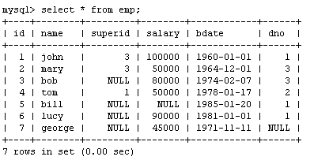
Another Example
Create a procedure to give a raise to all employees

Slide 17
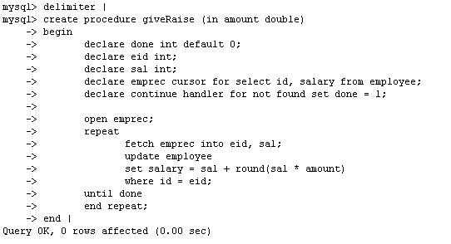
Another Example
Mathematical function round-off

Slide 18
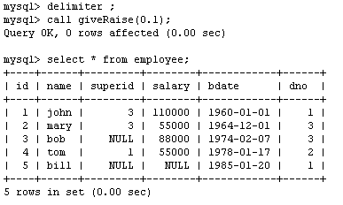
Another Example

Slide 19
Question :In the following example first of all we have to declare the Cursor and select the all records from Emp table. And after opened the cursor we fetch the record one by one from cursor. And then insert these record in product table.
delimiter $$ CREATE PROCEDURE firstCurs() BEGIN DECLARE d INT DEFAULT 0; DECLARE c_id INT; DECLARE c_name, c_address VARCHAR(20); DECLARE cur CURSOR FOR SELECT * FROM company; DECLARE CONTINUE HANDLER FOR NOT FOUND SET d=1; OPEN cur; lbl: LOOP IF d=1 THEN LEAVE lbl; END IF; IF NOT d=1 THEN FETCH cur INTO c_id,c_name,c_address; INSERT INTO products VALUES(c_id,c_name,c_address); END IF; END LOOP lbl; CLOSE cur; END$$

Slide 20
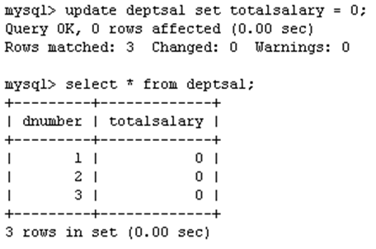
Example using Cursors
Suppose we want to update all the rows in deptsal simultaneously
First, let’s reset the totalsalary in deptsal to zero

Slide 21
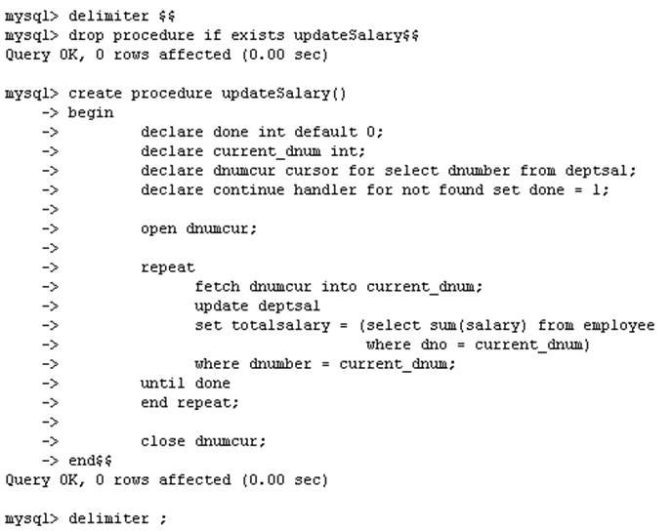
Drop the old procedure
Use cursor to iterate the rows

Slide 22
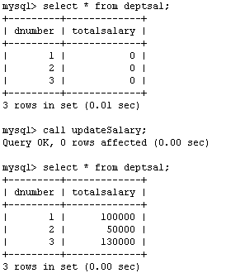
Example using Cursors
Call procedure

Slide 23
Cursors - Example
DECLARE done INT DEFAULT 0;
DECLARE CustName VARCHAR (30);
DECLARE NameCursor CURSOR
FOR SELECT Cust_Name FROM TBL_CUSTOMER;
OPEN NameCursor;
read_loop: LOOP
FETCH NameCursor INTO CustName;
IF done=25 THEN
LEAVE read_loop;
END IF;
done = done + 1;
END LOOP;
CLOSE NameCursor;
END;

Slide 24
Cursors
A database cursor is a control structure that enables traversal over the records in a database.
Cursors are used by database programmers to process individual rows returned by database system queries.
Cursors enable manipulation of whole result sets at once. In this scenario, a cursor enables the rows in a result set to be processed sequentially.
In SQL procedures, a cursor makes it possible to define a result set (a set of data rows) and perform complex logic on a row by row basis.
By using the same mechanics, an SQL procedure can also define a result set and return it directly to the caller of the SQL procedure or to a client application.

Slide 25
MySQL supports cursors inside stored programs. Cursors have these properties :
Read only:
you cannot update data in the underlying table through the cursor.
Asensitive:
there are two kinds of cursors: asensitive cursor and insensitive cursor.
An asensitive cursor points to the actual data, whereas an insensitive cursor uses a temporary copy of the data.
An asensitive cursor performs faster than an insensitive cursor because it does not have to make a temporary copy of data.
Non-scrollable:
you can only fetch rows in the order determined by the SELECT statement.
You cannot fetch rows in the reversed order. In addition, you cannot skip rows or jump to a specific row in the result set.

Slide 26
To use cursors in MySQL procedures, you need to do the following : - Declare a cursor. - Open a cursor. - Fetch the data into variables. - Close the cursor when done.

Slide 27
Declare a cursor :
Following statement declares a cursor and associates it with a SELECT statement that retrieves the rows to be traversed by the cursor.
DECLARE cursor_name CURSOR FOR select_statement
Open a cursor :
Following statement opens a previously declared cursor.
OPEN cursor_name
Close the cursor when done :
This statement closes a previously opened cursor. An error occurs if the cursor is not open.
CLOSE cursor_name

Slide 28
Fetch the data into variables :
This statement fetches the next row for the SELECT statement associated with the specified cursor (which must be open), and advances the cursor pointer.
If a row exists, the fetched columns are stored in the named variables.
The number of columns retrieved by the SELECT statement must match the number of output variables specified in the FETCH statement.
FETCH [[NEXT] FROM] cursor_name INTO var_name [, var_name] ...

Slide 29
Example : Cursor
The procedure starts with three variable declarations. The order is important. First declare variables. Then declare conditions. Then declare cursors. Then, declare handlers. If you put them in the wrong order, you will get an error message.

Slide 30
Example : Cursor
DELIMITER $$
CREATE PROCEDURE my_procedure_cursors(INOUT return_val INT)
BEGIN
DECLARE a,b INT;
DECLARE cur_1 CURSOR FOR SELECT s_id FROM student;
DECLARE CONTINUE HANDLER FOR NOT FOUNDSET b = 1;
OPEN cur_1;
REPEAT
FETCH cur_1 INTO a;
UNTIL b = 1
END REPEAT;
CLOSE cur_1;
SET return_val = a;
END; $$

Slide 31
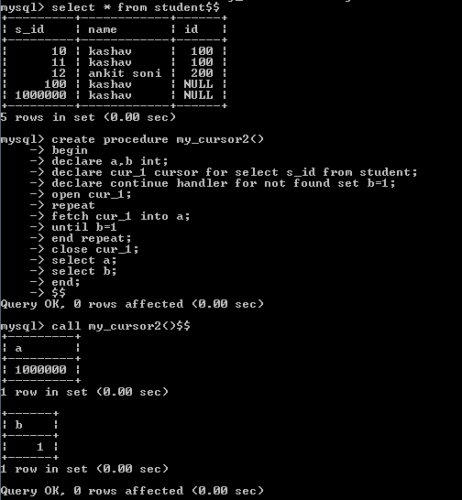

Slide 32
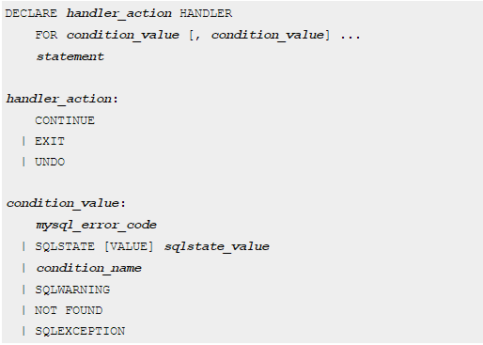
HANDLER

Slide 33
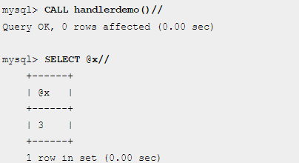
mysql> CREATE PROCEDURE handlerdemo ()
-> BEGIN
-> DECLARE CONTINUE HANDLER FOR SQLSTATE '23000' SET @x2 = 1;
-> SET @x = 1;
-> INSERT INTO t1 VALUES (1);
-> SET @x = 2;
-> INSERT INTO t1 VALUES (1);
-> SET @x = 3;
-> END;

